Slide 1
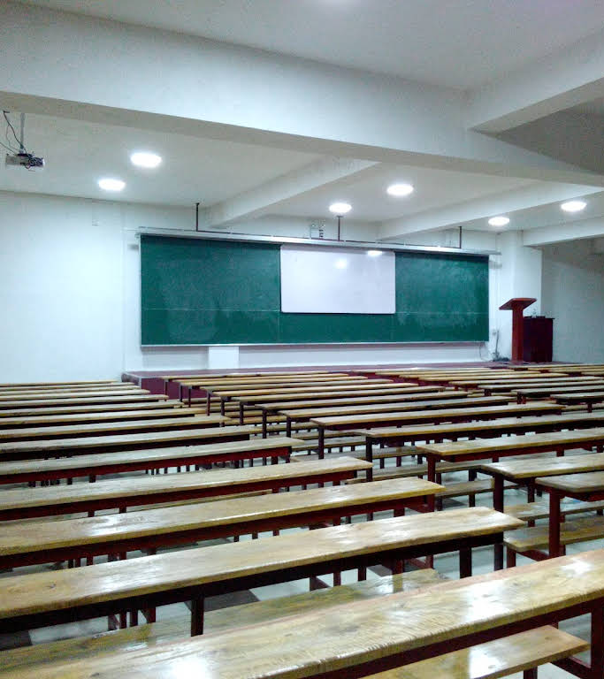
Student Enrollment and Class Management System
HUMAN COMPUTER INTERACTION - EC 9540
Group members :- 2019/E/166 & 2019/E/156

Slide 2

Content
Content.
Description.
Users.
Questionaries.
Data collection.
Requirement analysis.
Mental model.
Wire framing.
Interface Design.

Slide 3
Description
The system is for student management system for a tuition class.
Main activities:
Marking class fee.
Marking student attendance.
Marking printed tutorial issuing.

Slide 4

Users
Teachers.
Class organizers.
Managers of the class institutions.

Slide 5
Questionnaire
For each user different type of question provided.
Common type of question set also asked from all uses.
For class organizers:
1. What is the role of yours related to the institute?
2. What is the process of enrolling new students into the system?
3. What are the steps following when taking the student attendance?
4. What are the challenges you face when collecting monthly class fees?
5. What is the procedure followed when issuing printed tutorial materials?
6. What type of interface do you need in the system for enrolling new students?
7. Explain the information needed during each step? (Attendance marking, Tutorial issue)
8. Any features need to add extra to the system to become easy the system?

Slide 6
Teachers:
1. Rather than teaching what is the role of yours related to the institute?
2. What is the information needed to manage a class effectively?
3. What is the way of tracking class fee for a respective class?
4. What information is required to take from the system relevant to students?
5. Do you have any preference regarding the layout or navigation of the interface when
accessing the class information?
6. What are the requirements you expected from the system to help to improve the teaching and learning activities?

Slide 7
For manager of the institution:
1. What is the role of yours related to the institute?
2. What is the information required from the system for managing the institute?
For all types of users :
1. What are the usual challenges faced by the institute when managing the classes?
2. What are the key features that need to be added to the system which are benefit for all
the group of users?
3. What is the expectation of the system related to usability and training for all staff?
4. What are the requirements related to data security and access control

Slide 8
Data collection
Method followed:
Interviews.
Physical interviews.
Connect through mobile.
Data collection.
Teachers.
Class organizers.
Managers.
Notes:
Teachers: 15
Class organizers: 20
Managers.: 08

Slide 9
Requirement analysis
Functional requirements:
Class fee collecting method.
Process to mark printed notes are issued or not.
Mark attendance of each student.
Non functional requirements:
Security – Can not access by students.
Scalability – If number of student increase how to handle.
Usability – User friendly for end users and administrators.
Data base management.
Testing.

Slide 10
Mental model
Start
Login
Add new teacher
Class Manager
Class Organizer
Create New Class
Select the class
Add new student
Enter Class ID
Mark class fee & Attendance
Add New student
Log out
End

Slide 11
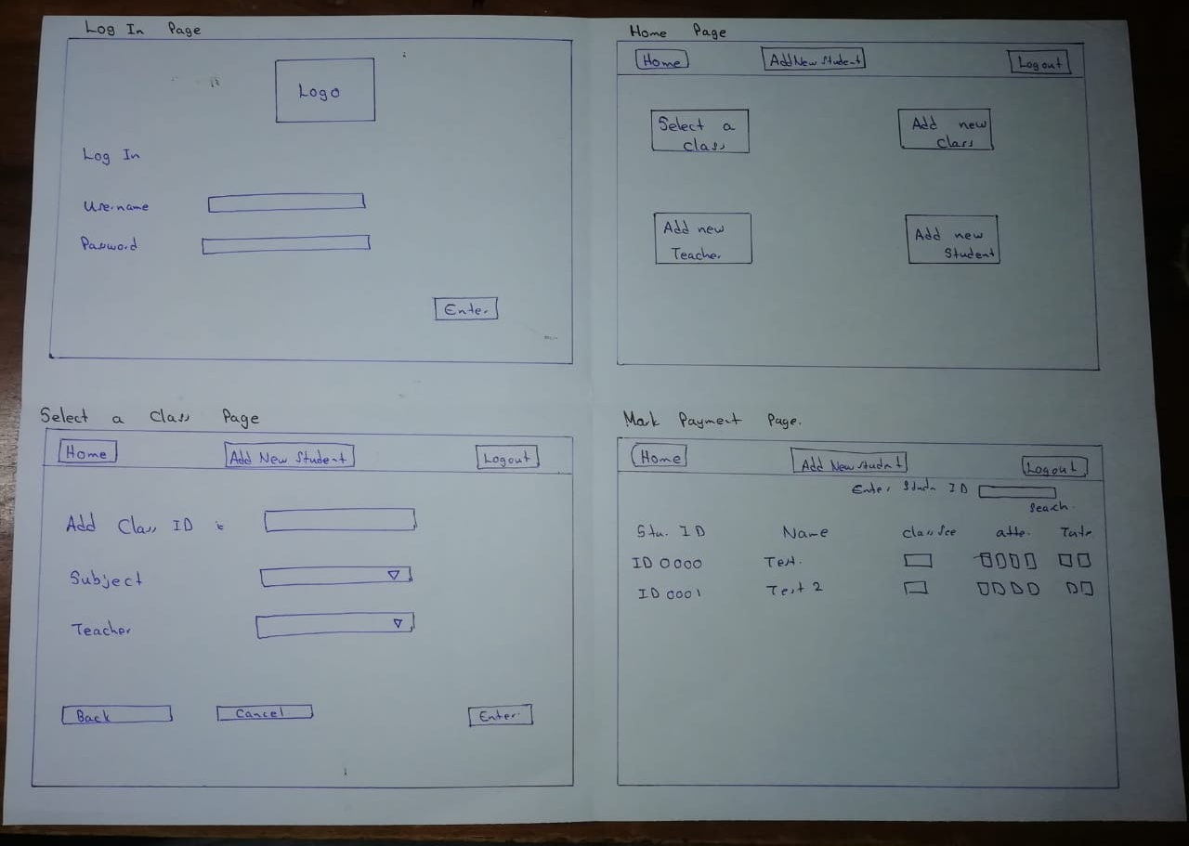
Wire framing

Slide 12
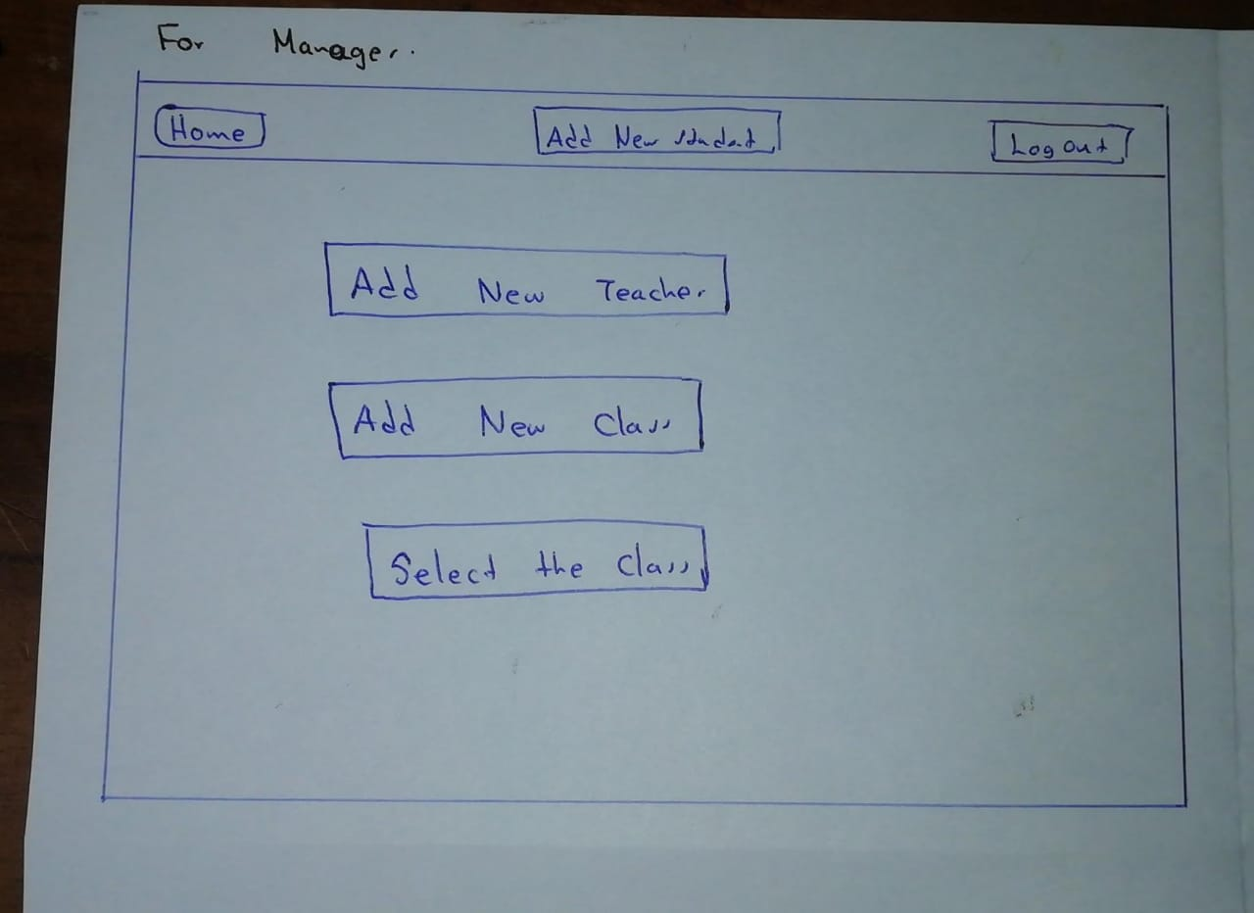
Wire framing

Slide 13

Interface design
Login Page

Slide 14
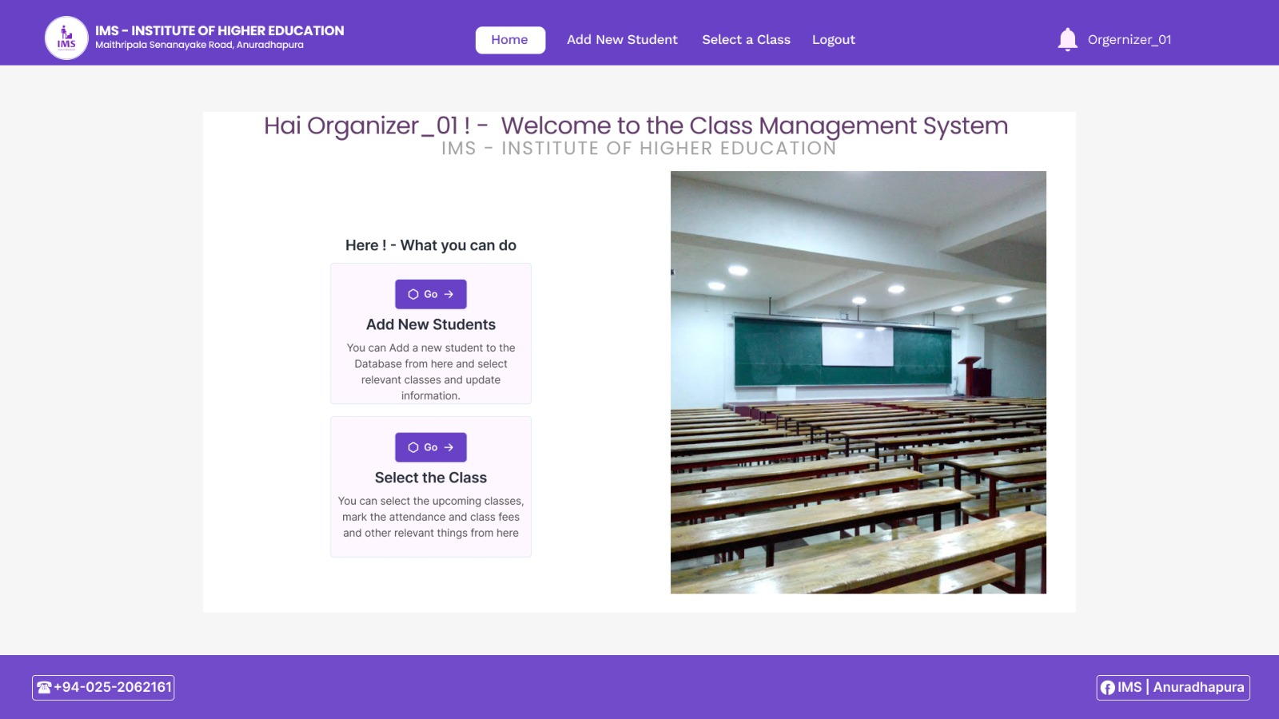
Interface design
Class organizer home page

Slide 15
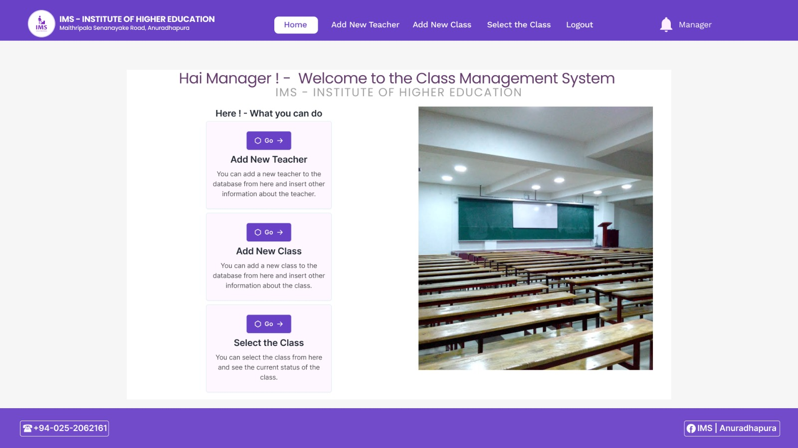
Interface design
Manager home page

Slide 16
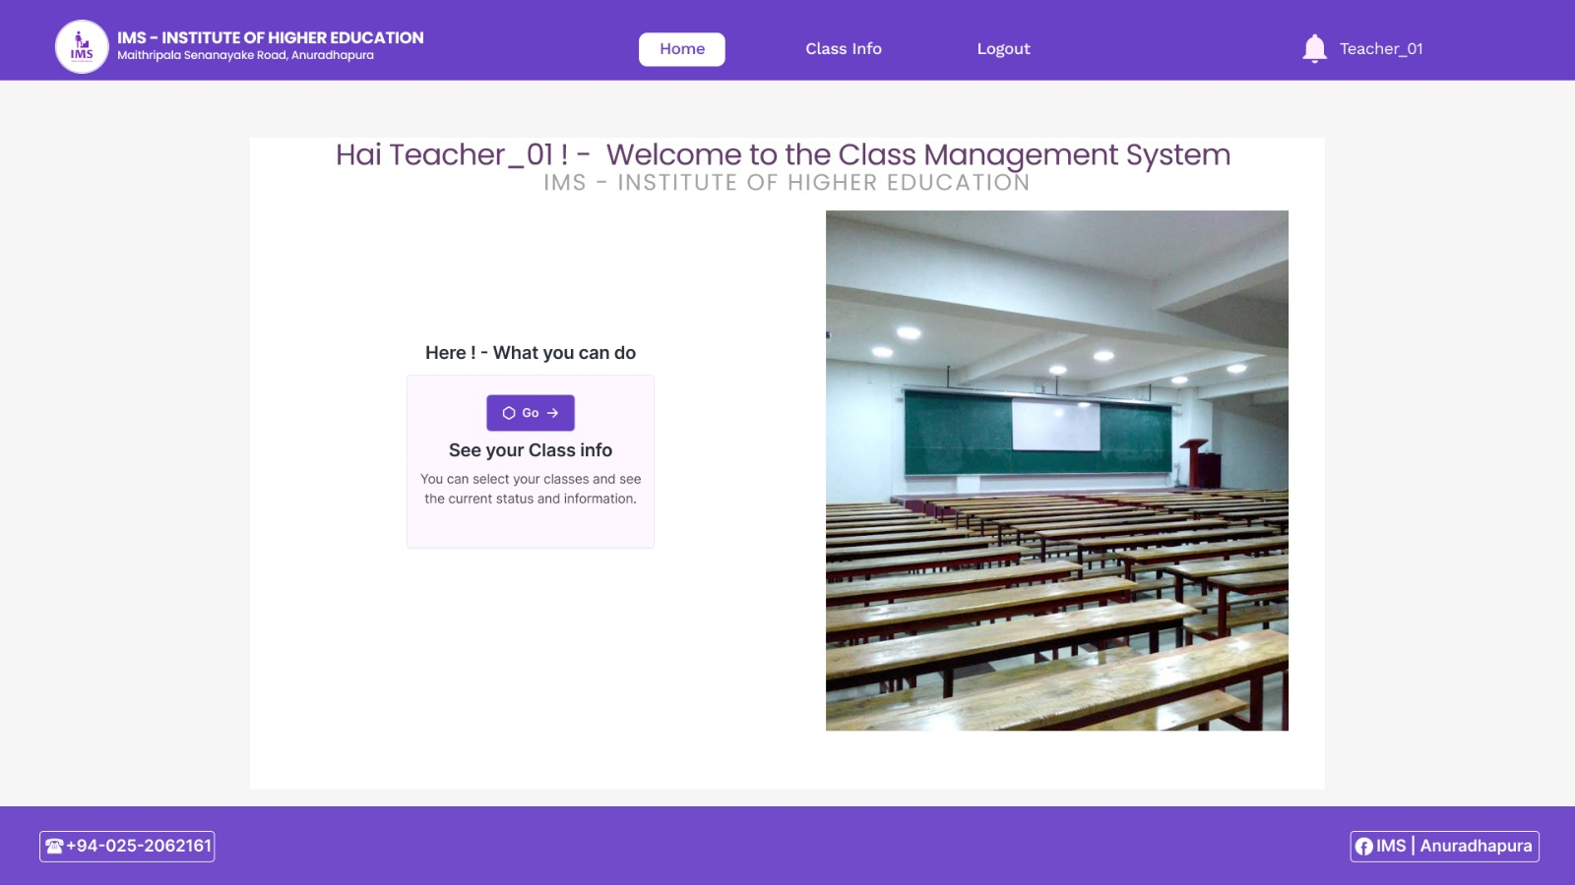
Interface design
Teacher home page

Slide 17
Thank you!
HUMAN COMPUTER INTERACTION - EC 9540
2019/E/166: Wijayawardhana W.A.H.A.
2019/E/156: Vishwajith A.G.N.

